Slide 1
MCQ Quiz Application
-Mini Project

Slide 2
Contents of this template
Abstract
Problem Statement
Proposed Solution
Webapp Overview
Implementation
Conclusion

Slide 3
Abstract
The main objective of the project MCQ Quiz Application is to manage the details of students, examinations, marks, courses and papers. The project is totally at administrative end and thus only the administrator is granted the access. The purpose of the project is to build an application to reduce the manual work for managing the MCQ quiz .

Slide 4
01
02
Objectives of Abstract
03
04
To create an appropriate platform for best managing of MCQ test
To overcome the time consuming issues and taking MCQ tests
To release the marks of the test taker as soon as possible
To manage the information of different tests

Slide 5
Problem Statement
A project to be developed to overcome the time consuming problem of manual system. Apart from that in current system, checking the answer sheets after taking test, waste the examiners time, so this application should check the correct answer and save the examiner time and carry the examination in an effective manner. The users who use this system don’t need to high computing knowledge and also system will inform them while entering invalid data.

Slide 6
Proposed Solution
The aim of this project is to computerized the existing manual system and help the examiners to save their valuable time and important data.
This project helps the examiners to manage their services in a good way and provide a better service to their users.
The project will reduce the manual process in managing examinations and all issues regarding that.

Slide 7
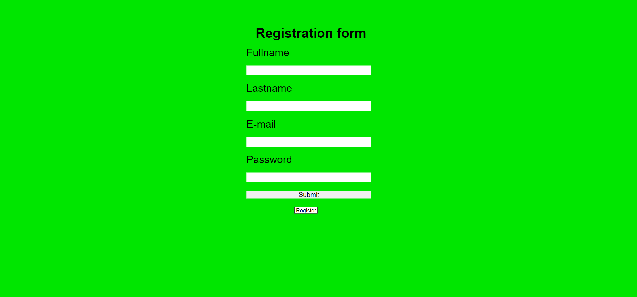
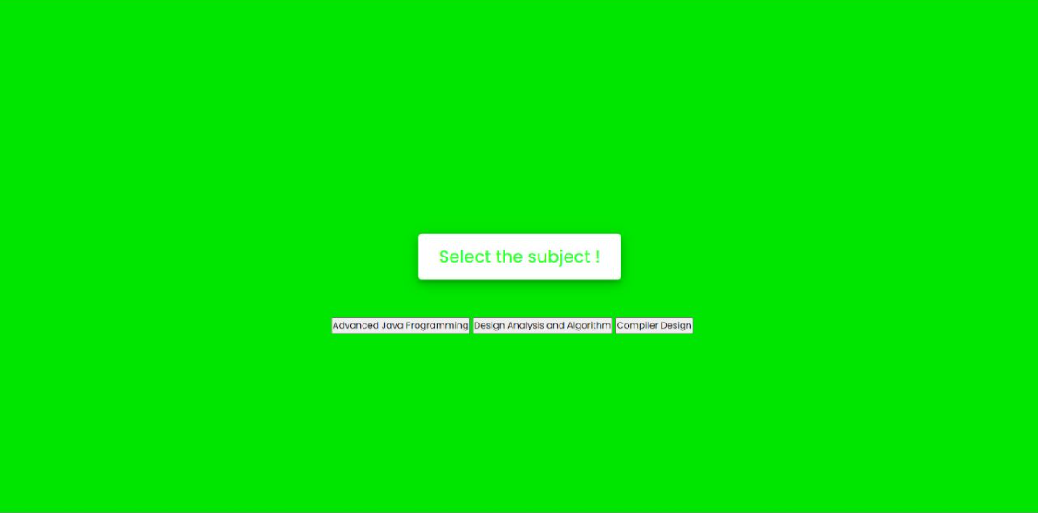

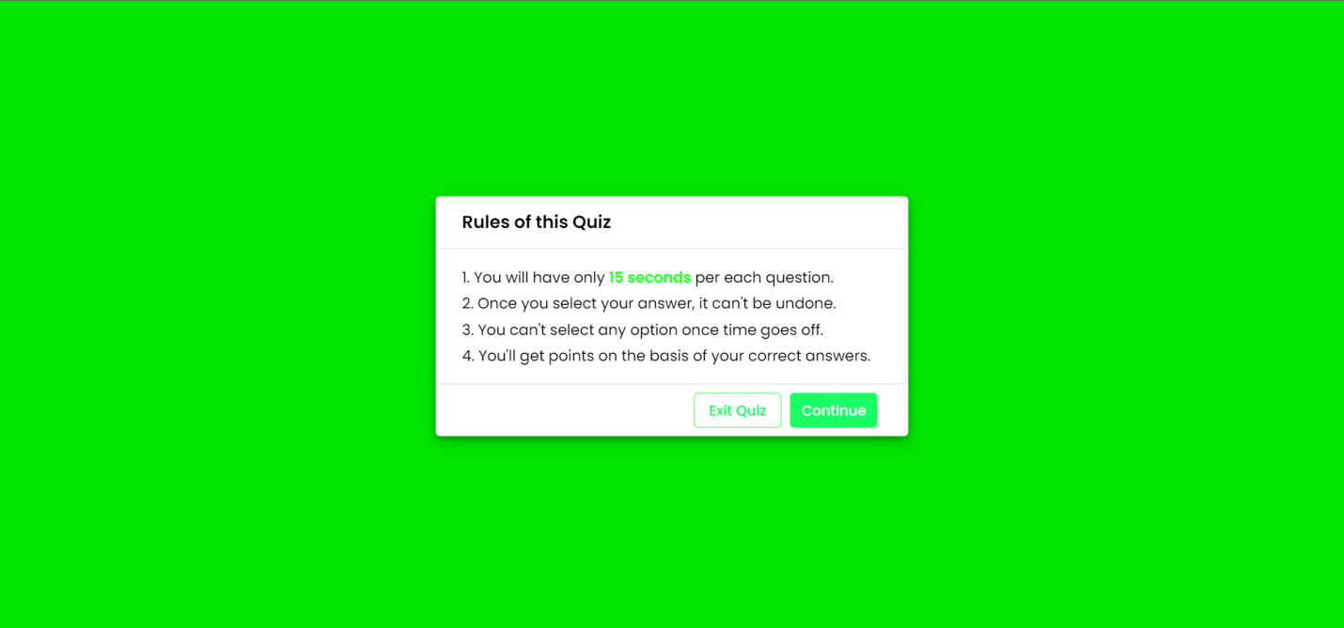
Webapp Overview

Slide 8
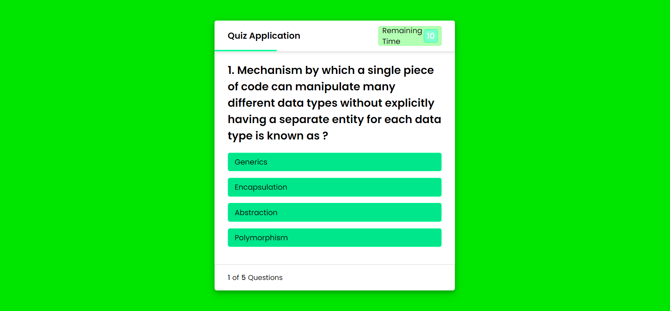
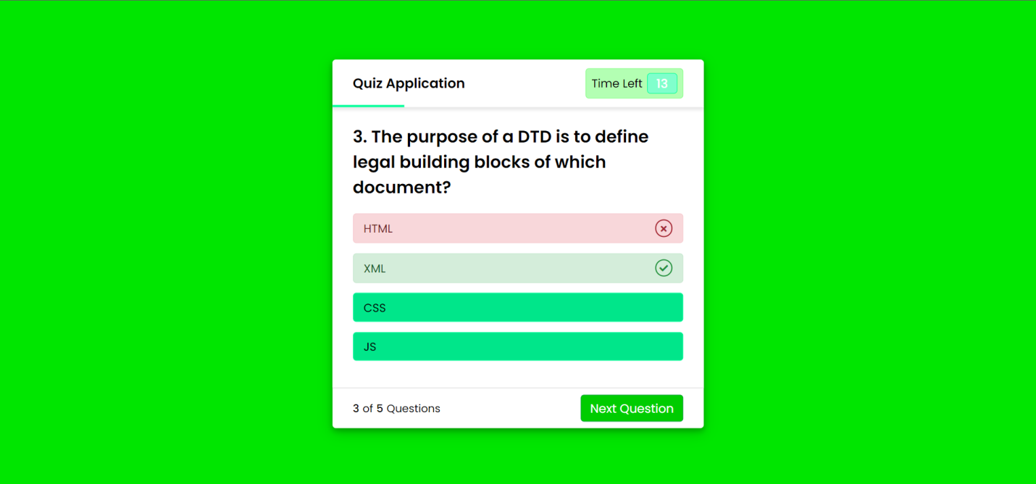

Webapp Overview

Slide 9
Implementation
file:///C:/Users/LEGION/Documents/html/new%20quiz%20marksim/home.html

Slide 10
Thanks
Team Members:
Marksim Karki P
Arees Muhmmed S
Rakshita T

